Slide 1
State Leadership Accountability Act
Department of Finance
Office of State Audits and Evaluations
Notes:
1

Slide 2
Agenda
Overview of SLAA
Top Ten Risks in 2015
Trends
Resources
Controls
Challenges From 2015
Upcoming Activities
Question and Answer

Slide 3
What is SLAA
Legal Requirement for Management to do the Following With Internal Controls:
Establish
Monitor
Maintain
Report

Slide 4
What is SLAA
Government Code Sections
13400-13407

Slide 5
What Changed in 2015
Launch of Web Portal
Defined Risks
Ongoing Monitoring Section

Slide 6
What is SLAA

Slide 7
2015 SLAA Summary
112 reports received
596 risks reported
97 entities contacted for clarification/revision

Slide 8
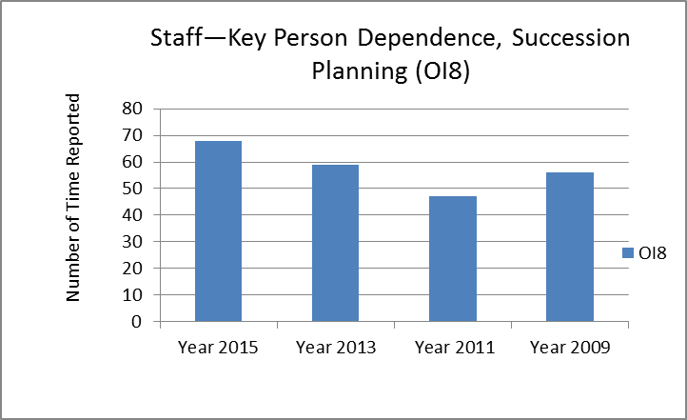
Most Common Risk 2015

Slide 9
Key Person Dependence, Succession Planning
Common Controls
Develop a Succession Plan
Follow Existing Succession Plan
Train/Cross-Train Staff
Write/Update Policies & Procedures

Slide 10
Key Person Dependence, Succession Planning
CalHR Workforce Planning Resources
http://www.calhr.ca.gov/state-hr-professionals/Pages/workforce-planning.aspx

Slide 11
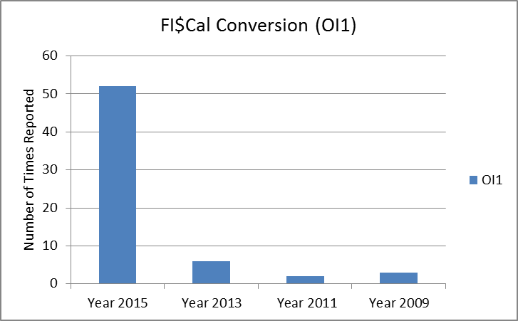
2nd Most Common Risk 2015

Slide 12
FI$Cal Conversion
FI$Cal Forums
http://www.fiscal.ca.gov/resources/fiscalforum.html

Slide 13
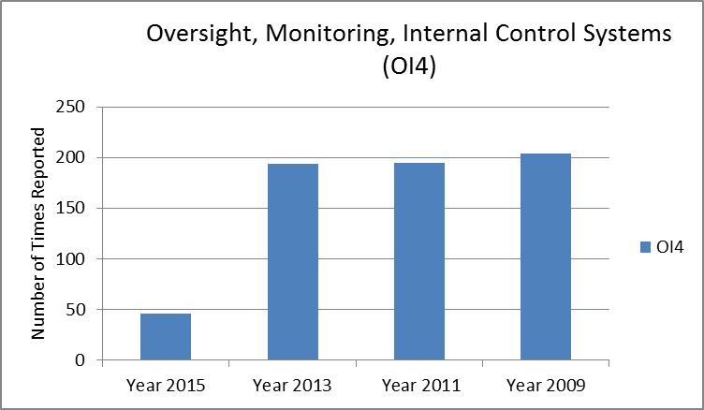
3rd Most Common Risk 2015

Slide 14
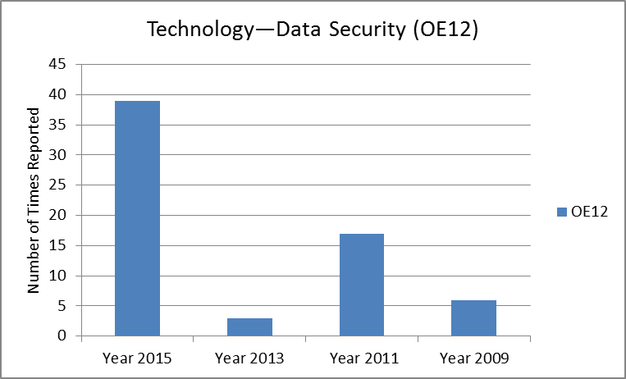
4th Most Common Risk 2015

Slide 15
Data Security
Data Breaches Visual
http://www.informationisbeautiful.net/visualizations/worlds-biggest-data-breaches-hacks/
California Information Security Office
http://www.cta.ca.gov/ois/

Slide 16
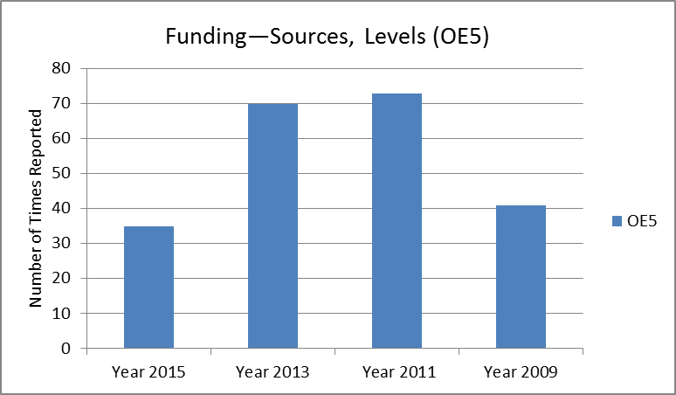
5th Most Common Risk 2015

Slide 17
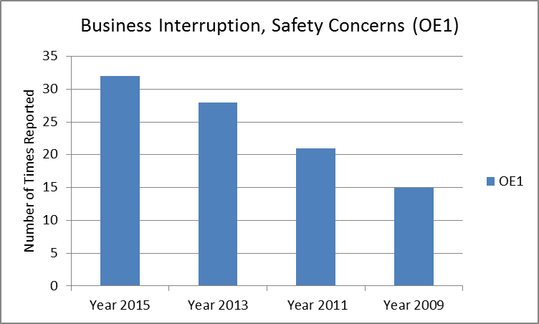
6th Most Common Risk 2015

Slide 18
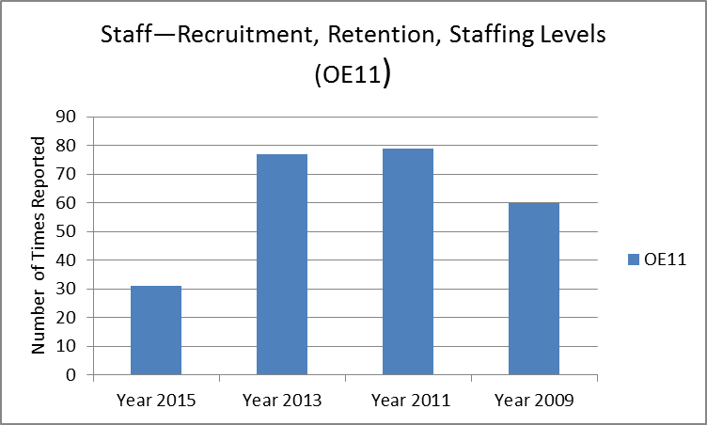
7th Most Common Risk 2015

Slide 19
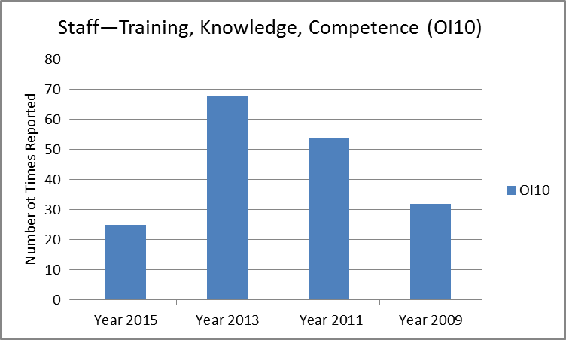
8th Most Common Risk 2015

Slide 20
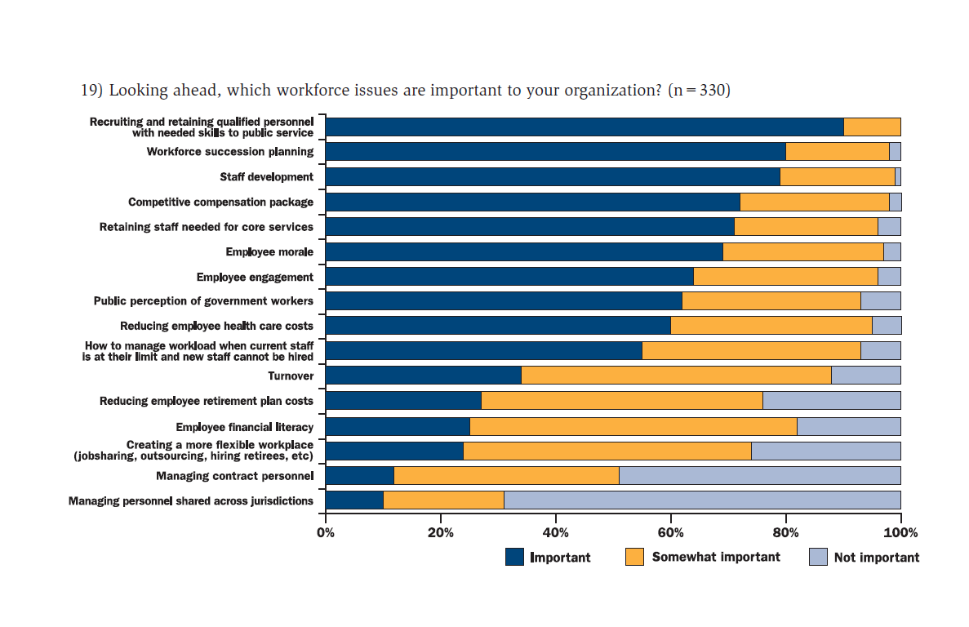
8th Most Common Risk 2015
http://slge.org/wp-content/uploads/2016/05/State-and-Local-Government-Workforce-2016-Trends.pdf

Slide 21
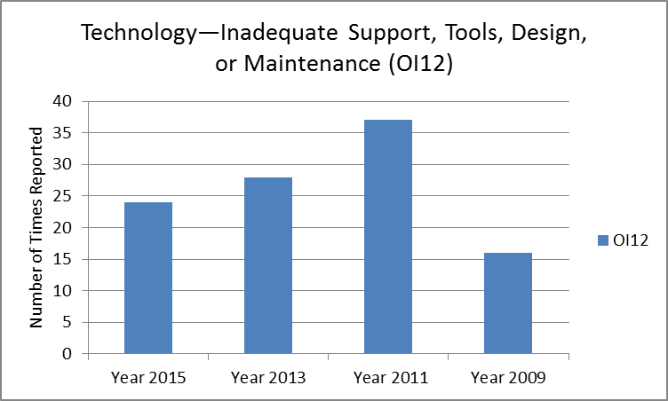
9th Most Common Risk 2015

Slide 22
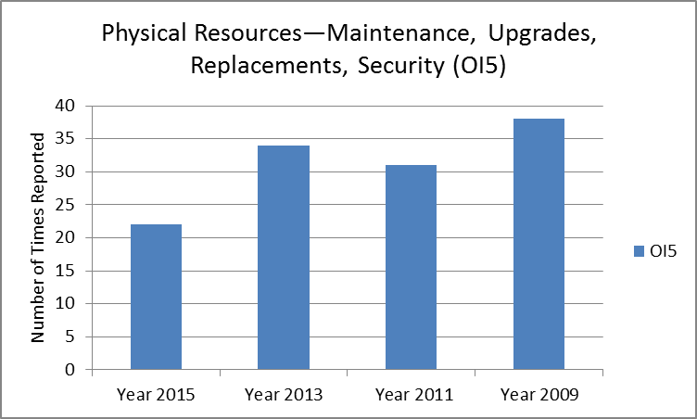
10th Most Common Risk 2015

Slide 23
Challenges in 2015
Other was Number 1 Risk Factor
Broad vs Narrow Definitions
Finding the Right Risk Factor

Slide 24
Challenges in 2015
Ongoing Monitoring
Process Limited to Reported Risks?
What is Fully Implemented?

Slide 25
Challenges in 2015
Risk Assessment Process
Who Should Be Involved?
What Criteria Was Used to Determine Reported Risks?

Slide 26
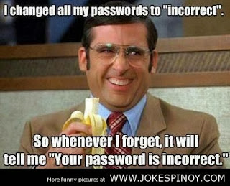
Challenges in 2015

Slide 27
Upcoming Activities
June 30, 2016 Corrective Action Plans
Preliminary Plans for Roundtable Meetings
Refining Risk Definitions
Web Portal Improvements
Recording Training

Slide 28
Questions

Slide 29
Contacting SLAA
http://dof.ca.gov/osae/fisma/
SLAAHotline@dof.ca.gov

