Slide 1
Fraud – Terrorism and the California Connection
Presented to:
California Association of State Auditors (CASA)

Slide 2
Presentation
International Terrorism Case Study/Overview
What is Data Mining and how to use it.
Other Resources
  FBI - Law Enforcement On-line (LEO); Special Interest Groups (SIGS)
  FBI - Internet Computer Crime Center (IC3)
  FBI - InfraGard
  Federal Trade Commission (FTC)
California Lottery Case Study/Overview

Slide 3
“THE LADY WHO
SET UP SHOP”

Slide 4
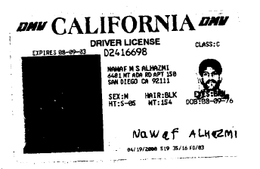

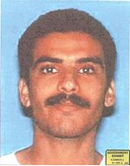
Nawaf al-Hazmi
Hani Hanjour
Khalid al-Mihdhar
Three of the five hijackers in 9-11 attack on the U.S. Pentagon.

Slide 5
Let’s look at the CDL
6481 Mt. Ada Rd., Apt. 150, San Diego, CA 92111
Issued: 4/19/2000, Field Office 519 (San Diego), Tech ID 35, Photo Tech 16

Slide 6
California DMV “Address Search”
“6481 Mt. Ada Rd., Apt. 150, San Diego, CA 92111” revealed:
Hani Hanjour (deceased)
Nawaf al-Hazmi (deceased)
Khalid al-Mihdhar (deceased)
Aafia Siddiqui (????????)
CID’s for Hanjour, al-Hazmi and al-Mihdhar - issued on same day,
  by same tech.
All four used the same address of record on 4/19/2000.

Slide 7
Vehicle Registration History:
Alfia Siddiqui (Original purchaser)
Hani Hanjour (Prior owner)
Nawaf al-Hazmi (Prior owner)
Khalid al-Mihdhar (Current owner)
California DMV “Reg. History”
“3JFZ283”
(Abandoned vehicle at Dulles
International Airport)

Slide 8
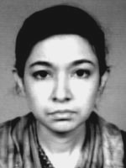
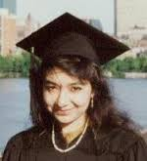

Who and where is Aafia Siddiqui?
MIT Student and Graduate!!!

Slide 9
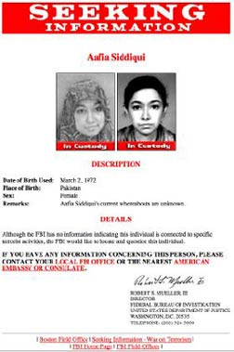

Dr. Aafia Siddiqui
Dr. Aafia Siddiqui, once declared world’s most wanted female terrorist according to the FBI is a Pakistan born, MIT graduated neuroscientist and a mother of three who is serving 86 years to life imprisonment.
Source: http://www.dhakacourier.com.bd/?p=2118/

Slide 10
Dr. Aafia Siddiqui
On a hot summer morning 18 months ago a team of four Americans – two FBI agents and two army officers – rolled into Ghazni, a dusty town 50 miles south of Kabul. They had come to interview two unusual prisoners: a woman in a burka and her 11-year-old son, arrested the day before.
Afghan police accused the mysterious pair of being suicide bombers. What interested the Americans, though, was what they were carrying: notes about a “mass casualty attack” in the US on targets including the Statue of Liberty and a collection of jars and bottles containing “chemical and gel substances”.
At the town police station the Americans were directed into a room where, unknown to them, the woman was waiting behind a long yellow curtain. One soldier sat down, laying his M-4 rifle by his foot, next to the curtain. Moments later it twitched back.
The woman was standing there, pointing the officer’s gun at his head. A translator lunged at her, but too late. She fired twice, shouting “Get the fuck out of here!” and “Allahu Akbar!” Nobody was hit. As the translator wrestled with the woman, the second soldier drew his pistol and fired, hitting her in the abdomen. She went down, still kicking and shouting that she wanted “to kill Americans”. Then she passed out.

Slide 11
Aafia TODAY
Recently considered in prisoner exchange with Pakistan.
Recently connected to WMD’s used in Syrian government attacks; ID’d as the “cook” and lead scientist.

Slide 12
Data Mining
All state agencies have data and ability to mine it.
Often over-looked and under-utilized.
Generally requires special programing (cost) to extrapolate information.
Time limited; more time/more costs.
Narrow search boundaries.
Any/all data is subject to mining.
Look for the “nuggets.”

Slide 13
OTHER RESOURCES

Slide 14
InfraGard
InfraGard is a partnership between the FBI and the private sector.
It is an association of persons who represent businesses, academic institutions, state and local law enforcement agencies, and other participants dedicated to sharing information and intelligence to prevent hostile acts against the U.S.
https://www.infragard.org

Slide 15
Integrated Message 13 - November 26, 2013
Submitted by content admin on Tue, 2013-11-26 18:09
Dear InfraGard Member,
With 84 InfraGard Members Alliances and nearly 20,000 members actively registered on the InfraGard network, providing for the growing communication needs of a nationally dispersed organization presents a tremendous challenge. While new liaison roles, including those of FBI Regional Coordinator and Sector Chief, have already proven their value in expediting information through human channels, additional support is needed in order to guide the accompanying increase in communication traffic.
InfraGard’s secure network provides a robust platform for information sharing, and has recently undergone a number of upgrades in order to allow FBI and INMA leadership to furnish the on-time email messaging and intelligence reports that lend membership much of its value. The network now supports secure, high priority messaging (FLASH) from InfraGard Headquarters to Coordinators, Presidents and members. Relevant intelligence products are also being processed and uploaded to the site far more rapidly than they have been prior, increasing their impact for members.
A redesign of public and member web interfaces for improved content, navigation, and usability will be deployed near the end of the 2013 calendar year, including a customizable home page for all current members. The iGuardian reporting tool will continue to be provided as a central resource by which members may submit cyber incidents directly to the FBI. Members will be required to register on the new site in order to view intelligence products and assets, and must log in and change passwords every 90 days in order to maintain site access and active member status.
At every level, seamless communication between InfraGard management and members is a priority and is key to preparedness and threat awareness. We are working to create an information rich environment—locally and online— that offers mutual benefit and encourages frequent engagement between government and private sector subject matter experts.
Sincerest regards,
FBI Cyber Division
Joseph M. Demarest, Assistant Director
Kenneth V. Jones, Chief
National Industry Partnership Unit
INMA
David Pekoske, Chairman of the Board
Sheri Donahue, President

Slide 16


Law Enforcement Online (LEO) via Law Enforcement
Enterprise Portal (LEEP)
Secure, Internet-based information sharing system for agencies around the world that are involved in law enforcement, first response, criminal justice, anti-terrorism, and intelligence.
  If you work for a law enforcement, criminal justice, or public safety agency, you can join LEO.
https://www.cjis.gov/CJISEAI/EAIController

Slide 17
LEO (cont’d)
Members can access or share sensitive but unclassified information anytime and anywhere.
  Virtual Command Center (VCC)
    VCCs provide a real-time situational awareness tool that can assist law enforcement and other authorities during many situations, such as special public events, warrant sweeps, investigations, and natural disasters.
  Law Enforcement Online Special Interest Groups (LEOSIGs)
    LEOSIGs allow members to participate in communities of specialized interest in order to securely share inform

Slide 18
Common Frauds (FBI)
Common Fraud Scams
- Telemarketing Fraud
- Nigerian Letter or “419” Fraud
- Identity Theft
- Advance Fee Schemes
- Health Care Fraud/Health Insurance Fraud
- Redemption/Strawman/Bond Fraud
Fraud Target: Senior Citizens
- Health Care Fraud/Health Insurance Fraud
- Counterfeit Prescription Drugs
- Funeral and Cemetery Fraud
- Fraudulent "Anti-Aging" Products
- Telemarketing Fraud
- Internet Fraud
- Investment Schemes
- Reverse Mortgage Scams
Investment-Related Scams
- Letter of Credit Fraud
- Prime Bank Note Fraud
- Ponzi Schemes
- Pyramid Schemes
Internet Scams
- Internet Auction Fraud
- Non-Delivery of Merchandise
- Credit Card Fraud
- Investment Fraud
- Business Fraud
- Nigerian Letter or "419" Fraud

Slide 19
Internet Crime Complaint Center (IC3)
Mission is to serve as the central clearinghouse and repository for complaints from industry and private citizens, in regard to Cyber Crime (computer intrusions, theft of intellectual property, and Internet fraud).
www.IC3.gov

Slide 20
Sample IC3 Trend Analysis Report
SIM CARD SWAP - The IC3 has recently received complaints involving subscriber identification module (SIM) swap fraud. SIM swap fraud occurs when an individual compromises your personal and cell phone information and obtains access to your SIM card. It is fairly easy for an individual to obtain your personal identification, cell phone information (number, provider, etc.), and contact your carrier to request a new SIM card. Once they obtain your information, they can call the carrier, pretend to be you, and obtain the new card. When the perpetrator receives and activates the SIM card, the victim’s card will be deactivated. The victim may notice their phone will no longer transmit messages or calls. At this time, all alerts, payment confirmations, and other various SMSs will be transmitted to the fraudster. SIM swapping is sometimes the second phase of the scam. Initially, the perpetrator will send phishing emails to obtain credit card or bank account information. If the perpetrator receives enough information, he/she can wipe out your bank account, run up your credit cards, and even open new accounts or create fraudulent identification documents.
Some tips to protect yourself from SIM Card Swap fraud as noted on the ABSA site, http://www.absa.co.za/Absacoza/Security-Centre/Latest-Scams/SIM-Swaps, include the following:
• First, protect your personal and cell phone account information from other parties and websites. Account information includes, but is not limited to, cell phone contract type, debit order dates, ID, addresses, and transaction behavior.
• Be observant and aware of the network connectivity status of your cell phone. If you notice a reduced amount of or no activity pertaining to SMS notifications, there may be a problem, and you should check into possibly having an issue with the SIM card on your phone.
• Some Mobile Network Operators send customers an SMS to alert the customer of an instruction to SIM swap – which means the customer can act quickly to stop this fraud in its tracks by contacting your mobile operator.
• If you begin receiving numerous annoying calls, choose not to answer the calls instead of turning off your cell phone. Numerous annoying calls could be a ploy to get you to turn off your cell phone or switch the volume to silent, which will prevent you from noticing a change to your connectivity.

Slide 21
FEDERAL TRADE COMMISSION
FTC.GOV/IDTHEFT
“TAKING CHARGE: WHAT TO DO IF YOUR
IDENTITY IS STOLEN”

Slide 22
Lottery Scams
In his first 3 months; Investigator Gary “Reid” Galbreath has uncovered two highly sophisticated lottery scams; issued multiple Search Warrants; and has identified multiple international players.
Complaint to IC3; Intelligence handed to them on a “silver platter.”
FBI and Florida Department of Law Enforcement are currently involved.

Slide 23
Facebook Lottery Scam
Original complaint received via 1-800-LOTTERY from customer in Oceanside, CA
Contacted via Facebook email by a “California Facebook lottery agent.”
Investigator took over contact with the suspects via Facebook/Email.
Sent official documents and told the FBI was aware of the contest and was overseeing it.
Ultimately told to send money via Western Union to pay the processing fee.

Slide 24
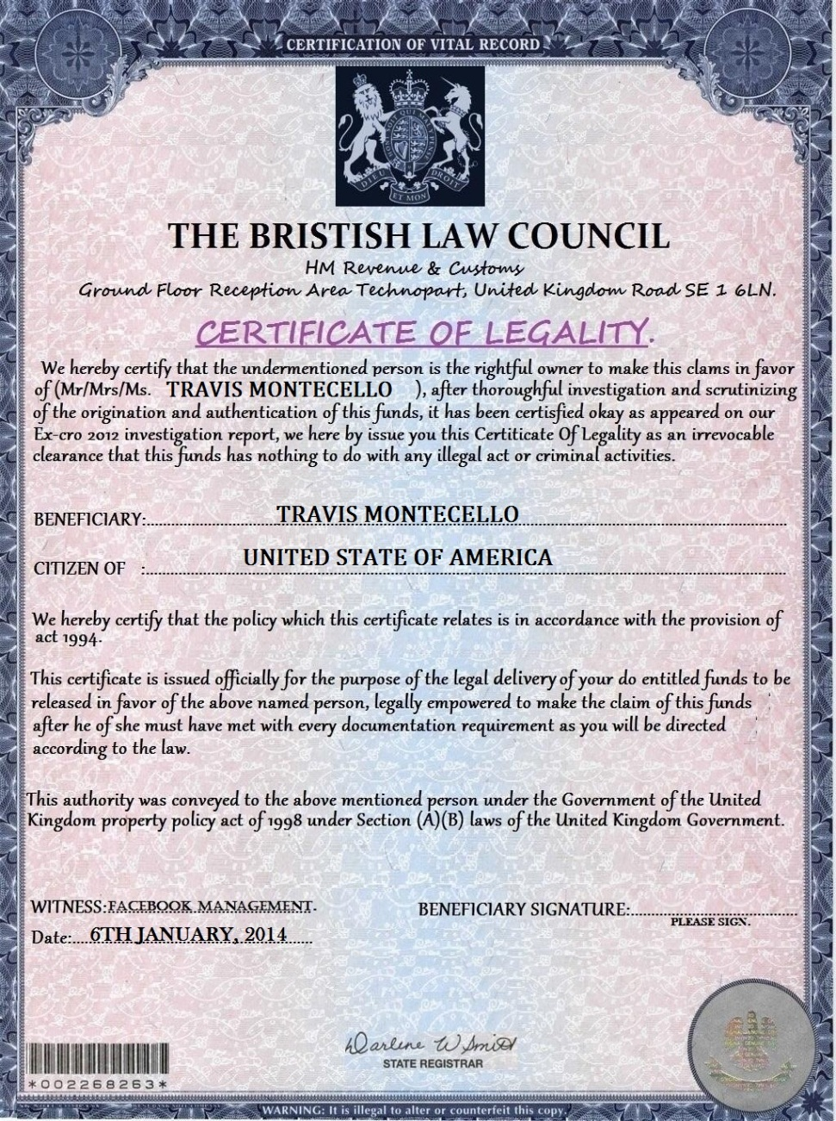
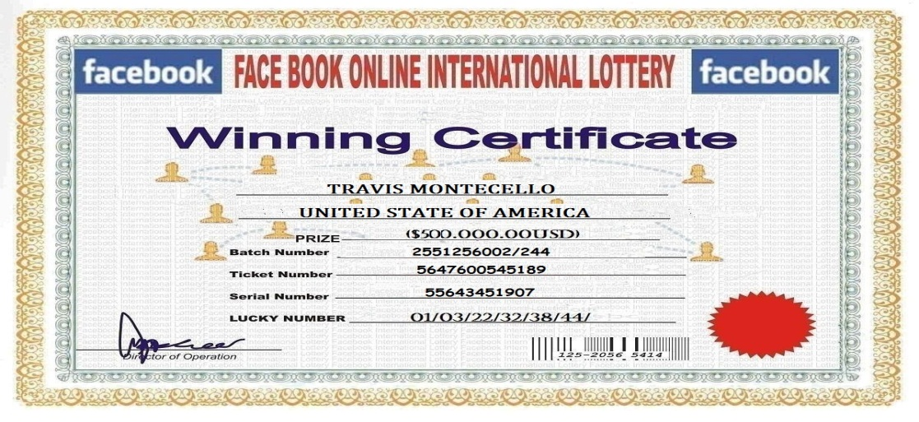
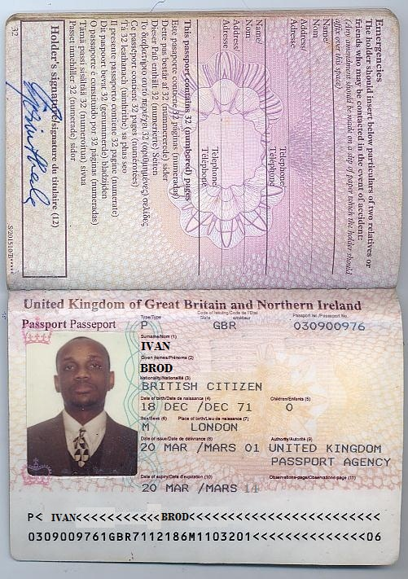
“Official Documents”

Slide 25
California Lottery Scam
CSL contacted by concerned customer via Facebook email.
Informed that a “Ca-Lottery Agent” contacted her.
After several complaints, SLED was notified and asked to investigate.
Replica Facebook page was located that mirrored the official CSL page.
Multiple CSL photographs and copyrighted images taken used as part of the scam.

Slide 26
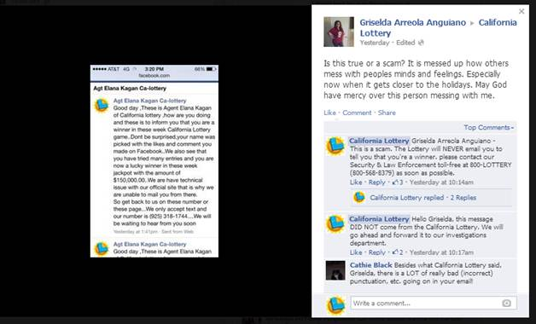
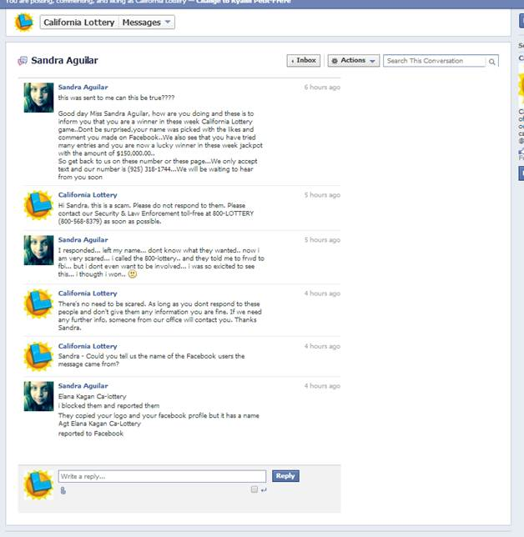
California Lottery Scam

Slide 27
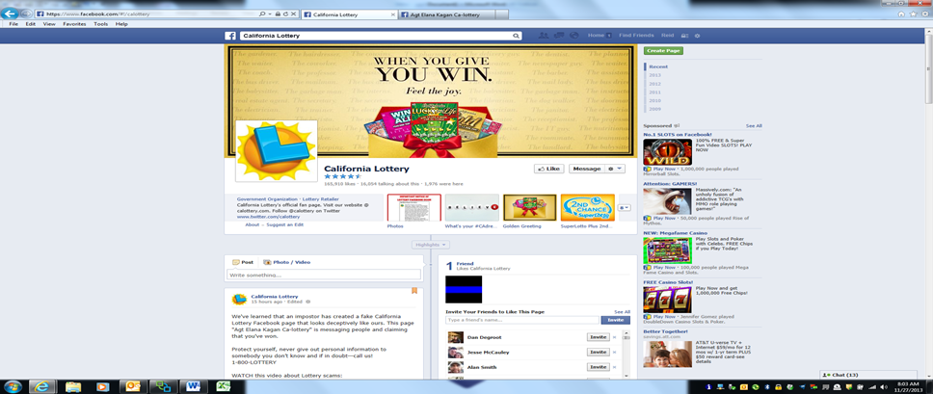
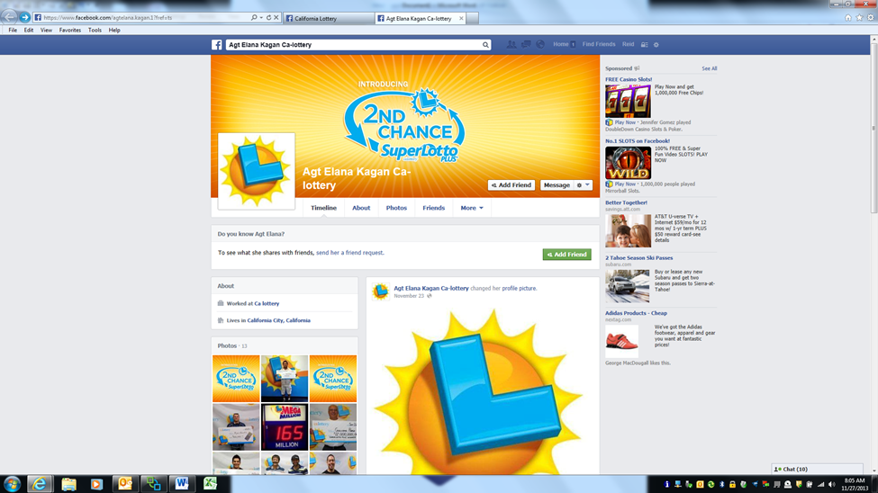
California Lottery Scam

Slide 28
California Lottery Scam
The suspects used the same formula as the Facebook lottery scam.
Winners told they have to pay a processing fee to collect their winnings.
Payments made via Western Union and Green Dot money packs.
9 Search warrants issued, 1 suspect identified, 1 victim identified, multiple suspects accessing the same account in the UK, Nigeria and the US in Florida.

Slide 29
California Lottery Scam
Data mining has led to at least 4 similar lottery scams being shut down.
Information being shared with other agencies to apprehend the suspects.
Increased awareness thanks to information sharing.

Slide 30
QUESTIONS/CONTACT:
Derek Beverly/Gary Galbreath
DEREK.BEVERLY@LEO.GOV
916-759-4457 CELL
DBEVERLY@CALOTTERY.COM
916-822-8245
GARY.GALBREATH@LEO.GOV
916-956-8055 CELL
GGALBREATH@CALOTTERY.COM
916-822-8209

